Slide 1
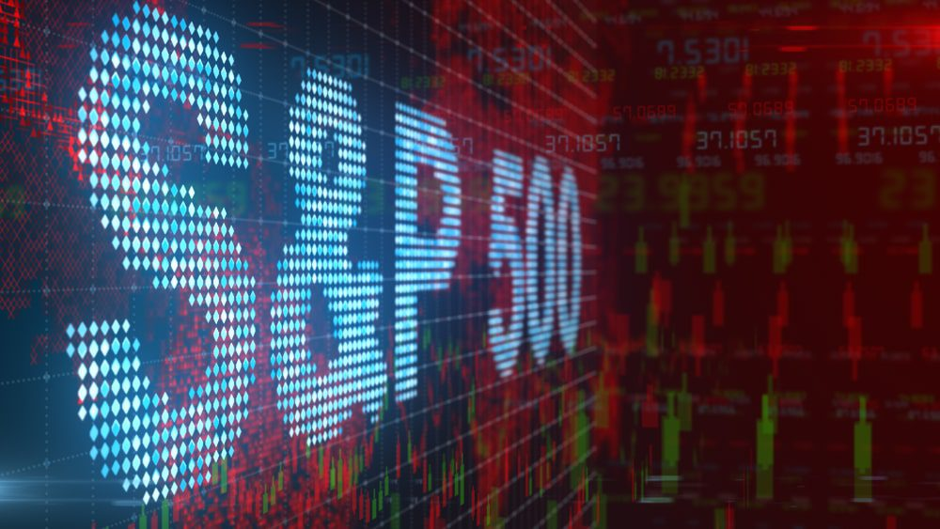
Analysing
S&P500 Stock Index
and the performance of its Economic Sectors
Jonathan Martinez
Mylene Marsden
Christian Torres
Cindy Wong

Slide 2
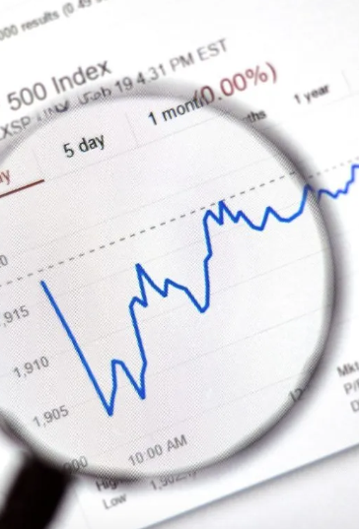
INTRODUCTION
What is the S&P500 and why it is important in the US stock market?
The S&P 500 Index, or Standard & Poor's 500 Index, is a market-capitalization-weighted index of 500 leading publicly traded companies in the U.S. It covers approximately 80% of available market capitalisation. In other words, S&P500 tracks the stock performance of 500 large companies listed on stock exchanges in the United States and it is one of the most commonly followed equity indices.
The S&P 500 index is the most commonly used benchmark for determining the state of the overall economy. Many investors also use the S&P 500 as a benchmark for their individual portfolios. The key advantage of using the S&P 500 as a benchmark is the wide market breadth of the large-cap companies included in the index. The index can provide a broad view of the economic health of the U.S.
It represents the stock market's performance by reporting the risks and returns of the biggest companies. Investors usually look at the S&P 500 to assess how the overall stock market is doing. This index is considered a leading U.S. economic indicator.
Reference: https://www.investopedia.com/terms/s/sp500.asp https://www.thebalancemoney.com/what-is-the-sandp-500-3305888 https://www.spglobal.com/spdji/en/indices/equity/sp-500/#data https://www.spglobal.com/spdji/en/indices/equity/sp-500/#overview

Slide 3







DATA COLLECTION
Sources
Financial data for every need.
Types of data files
Access stocks, forex and other financial assets
Stock Market Quotes & Financial News

Slide 4
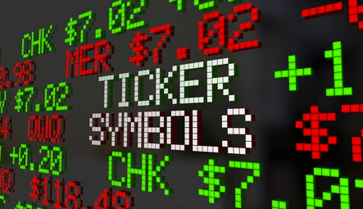
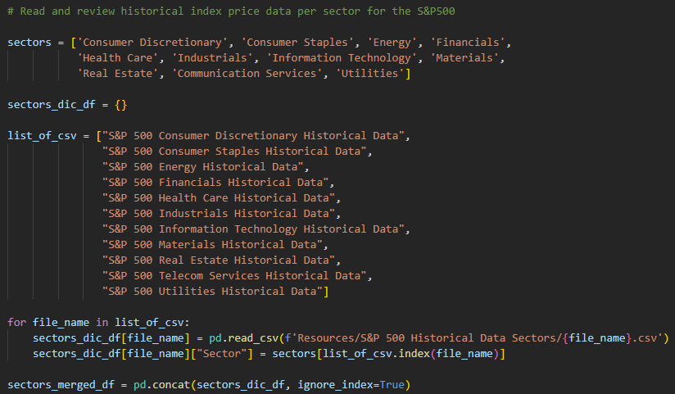
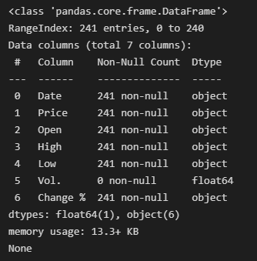
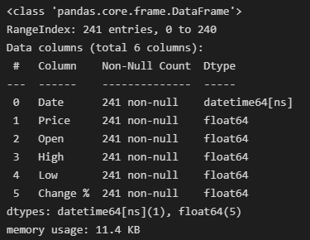
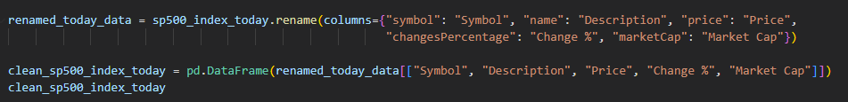
DATA CLEANING
Adjust datatypes
Merge DataFrames
Rename columns and filter DataFrames

Slide 5
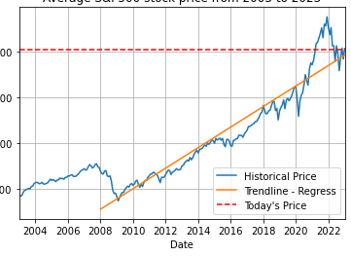
TREND OF S&P 500, CURRENT PRICE AND PREDICTION
Today’s S&P500 stock price from
Historical S&P500 stock price from

Slide 6

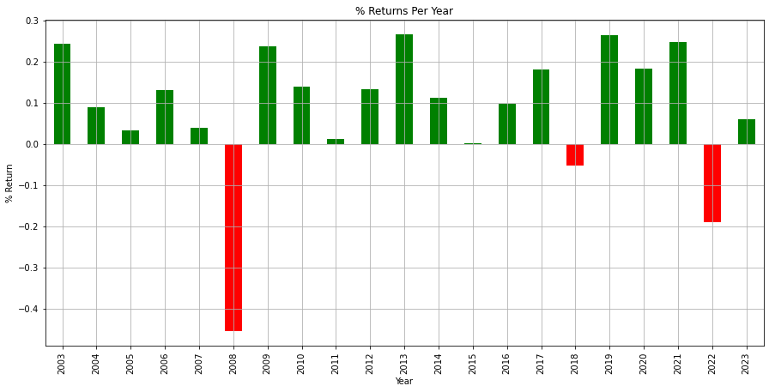
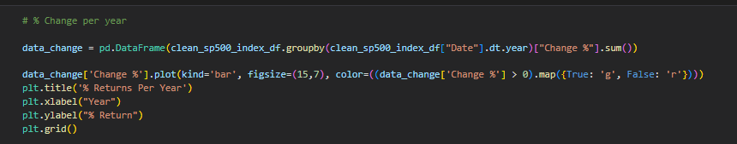
% of RETURN of S&P 500 over the last 20 YEARS (2003 to 2023)
Since 2003, S&P 500 has only fallen 3 times.
2008 was the year with the lowest return, followed by 2018 and then 2022!
Every five-year period following one of the worst years in the stock market saw positive returns!
Notes:
The S&P 500 bottomed out in 2008 was in tandem with other stock markets across the globe, which was known as the Great Recession.

Slide 7
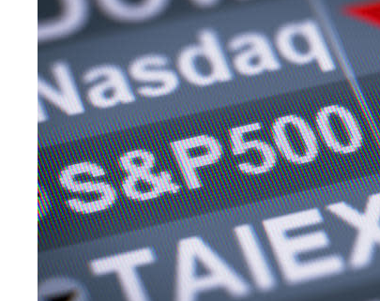
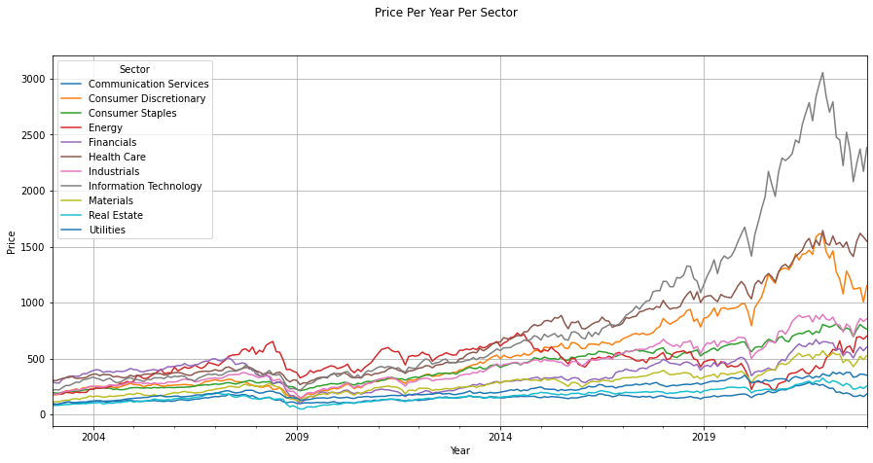
Performance of each SECTOR of the S&P 500 based on AVERAGE PRICE
between 2003 to 2023
TOP 3 out-performing sectors!
Technology
Health Care
Consumer Discretionary

Slide 8
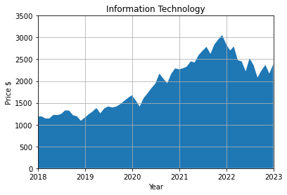
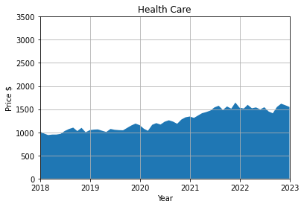
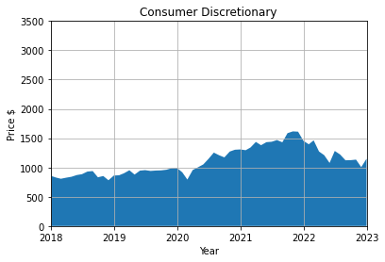
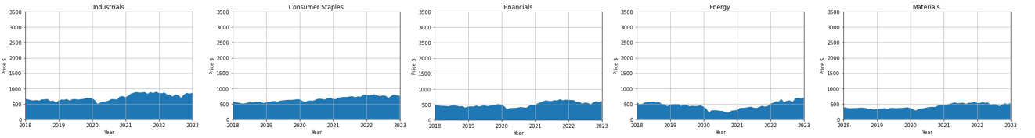
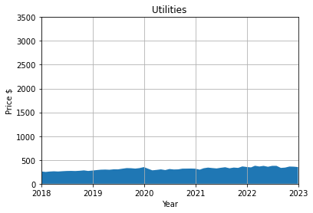
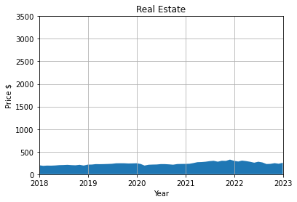
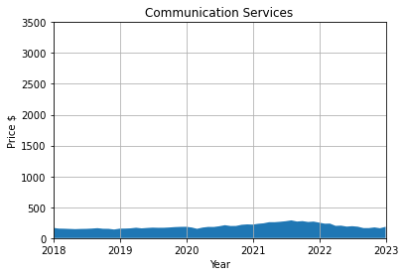
Performance of each SECTOR of the S&P 500 based on AVERAGE PRICE
TOP 3 out-performing sectors!
Technology
Health Care
Consumer Discretionary
TOP 3 under-performing sectors!
Utilities
Real Estate
Telecom Services
Notes:
So these graphs, we could see that the top performing sectors where they have the biggest difference in terms of prices are Information Technology, Consumer Discretionary and finally Health Care.
Information technology is by far the sector that has outperformed, meaning that they have the highest growth, since 2020 by a wide margin where 2020 is the critical year where COVID-19 outbreak happens.
The next top sectors include the consumer discretionary products and services such as durable goods, high-end apparel, entertainment, such as Netflix and automobiles.
During COVID-19 outbreak, the consumers would have more disposable income to spend on discretionary items and less concern over saving for tough times. This leads to a greater demand for consumer discretionary products. Hence the increase.
Then it was health care which shows the third greatest performing sector and this makes sense because people will need to visit the doctor, getting medication and spend money on items related to health care in order to prevent/ recover from the COVID-19.
The top 3 sectors that are most resistant to changes, meaning the less movement during the outbreak include the utilities, real estate and telecom services. This is because they are always in demand regardless of the state of the business cycle.

Slide 9

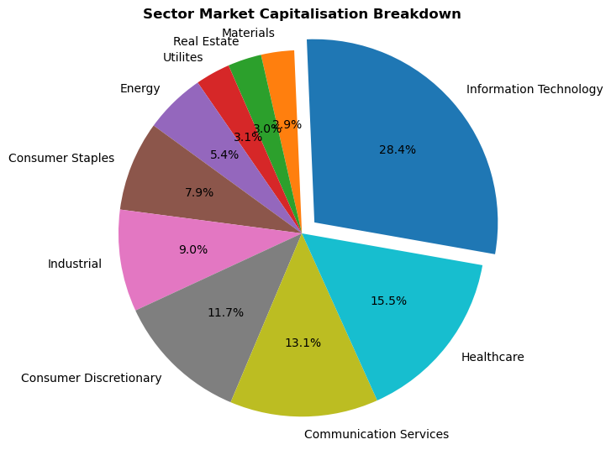

% Participation of each S&P 500 SECTOR between 2003 to 2023
Notes:
Market capitalization is valued by the total value of all companies shares of stock; calculated by multiplying the price of a stock by its total number of outstanding shares. To understand the status of today’s market capitalization value an API has been used and a data frame has been cleaned to breakdown the participation value amongst each sector. As visually shown through a pie chart display, Information Technology at 28.4% and Healthcare at 15.5% are the two most valued areas following the rest below Communication Services at 13.1%. What this information displays to the public is that Information Technology and Healthcare have higher market cap to signify a larger presence in the market, indicative of secure financing stock index, have a more consistent stream of revenue, generally less risky and capitalize on brand recognition. Top contributor for Information Technology and Healthcare can also be looked at; where the top 5 performing stock index can be broken down to showcase the hierarchy market capitalization value per company for set sector.

Slide 10

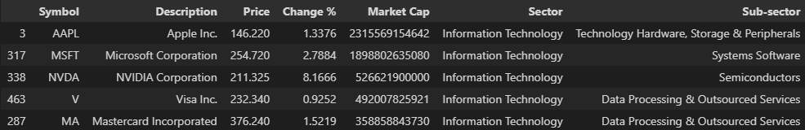
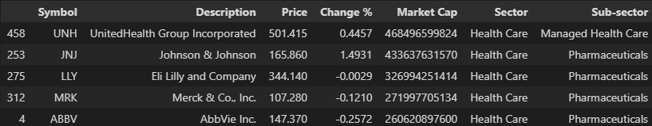
Top 5 Performing S&P 500 Sectors between 2003 to 2023
Information Technology
Health Care

Slide 11

Notes:
So, as conclusion, based on what we can see here from our findings, the winners during this down market, in other words, recession – proof, still performing well even after the economy slows are:-
- Healthcare, Utilities, Real Estate, Consumer staples, Communication
The good news is that even though the stock market is down, it doesn't mean that every sector is suffering and the bad news is that there’s no guarantee the stocks / industries that we mentioned will continue to increase in value.
Nobody can predict the stock market’s future and with data analytical skills, it just help us to predict what will happen next based on the information that we have.

